Slide 1


What You Should Know During
Open Enrollment
Plan – Enroll - Verify
Notes:
Welcome to the MTA’s Open Enrollment Webinar for the 2024 Benefit year!

Slide 2
View Benefits on My MTA Portal
Open Enrollment Information
MTA Medical Opt-Out Program
What’s Changing for 2024
Medical Plan Options
Prescription Drug Plan
Dental Plan Options
Vision Coverage
Tax-Favored Programs
Resources Available to You
Agenda
Notes:
Today, we’ll be covering the following topics:
Viewing Benefits on My MTA Portal
Open Enrollment Information
The MTA Medical Opt-Out Program
What’s Changing for 2024
Medical Plan Options
Prescription Drug Plan
Dental Plan Options
Vision Coverage
Tax-Favored Programs
Resources Available to You

Slide 3


Open Enrollment
Open Enrollment is the time to:
Add, remove, or change your current benefit enrollment selection
Add or remove dependents
The elections made during open enrollment cannot be changed during the year unless there is a qualified status change, such as:
Marriage or legal separation
Birth, adoption, or legal custody of a child
Change in your dependent’s employment status
Loss or gain of coverage
You can cover the following dependents on your MTA-sponsored medical, dental*, and vision plans:
Spouse or Domestic partner
Child(ren) up to age 26
Orthodontia is covered until the age of 23, unless dependent is “fully banded”*
Notes:
Open Enrollment is the time of year to add, remove, or change your current benefit enrollment selections as well as add, change, or remove eligible dependents
The elections made during open enrollment cannot be changed during the year unless you experience a qualified status change such as marriage, legal separation, the birth, adoption, or legal custody of a child, change in your dependent’s employment, or the loss or gain of coverage
On your plans, you can cover the following dependents: spouse or domestic partner and children up to age 26
For orthodontia, dependents are covered until the age of 23, unless they are fully banded before this time. If fully banded, this benefit will be extended until the dependent reaches the age of 26

Slide 4

Benefits
Notes:
Let’s get started!

Slide 5

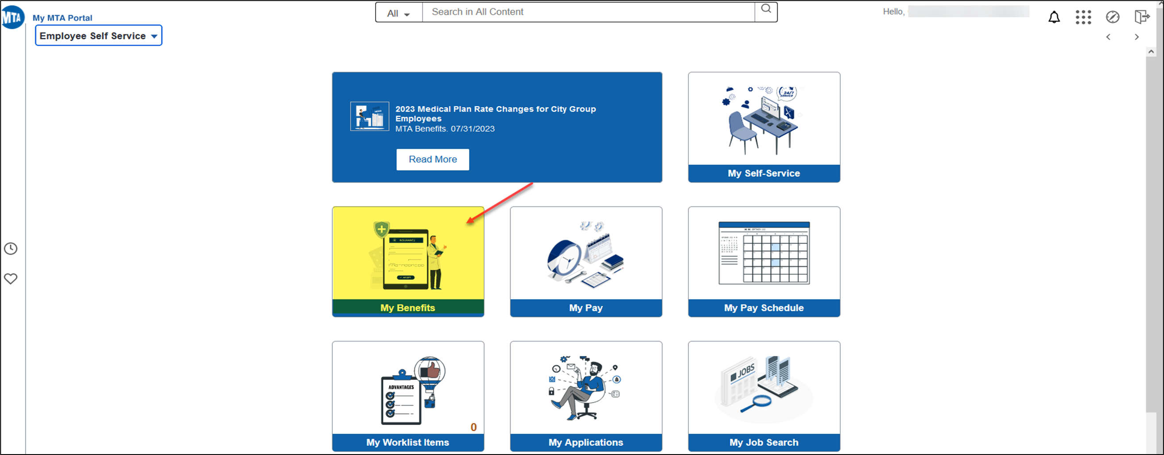
BENEFITS INFORMATION
Notes:
Did you know you can view your benefits information on the My MTA Portal?
Let’s take a closer look! By clicking on the “My Benefits” tile, it will allow you to view the following information by clicking each tile:

Slide 6
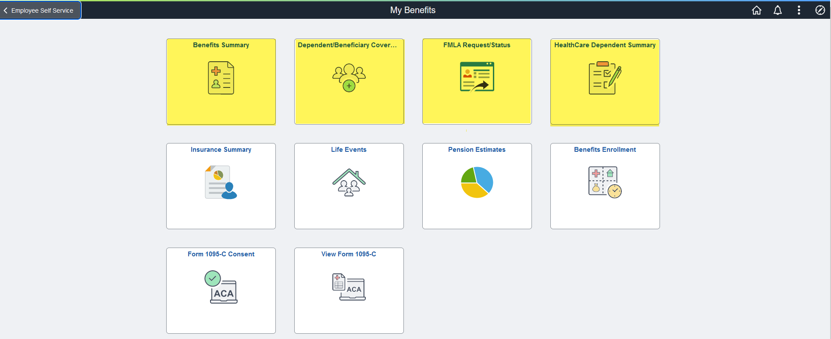
BENEFITS INFORMATION
Notes:
-Benefits Summary
-Dependent/Beneficiary Coverage
-FMLA requests and status info
-Health Care Dependent Summary
Just to name a few options…

Slide 7
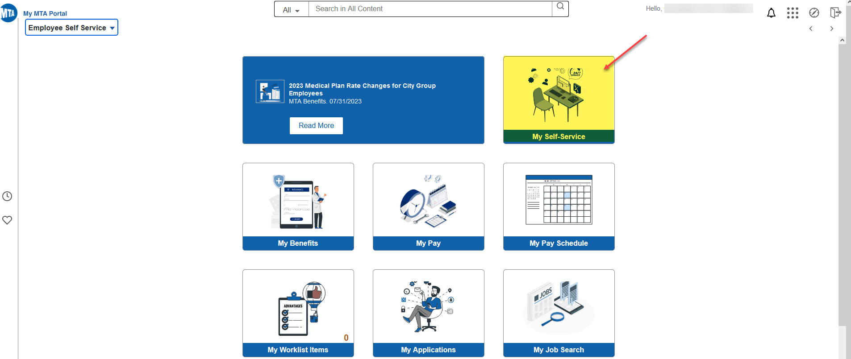
PERSONAL INFORMATION
Notes:
Clicking on the My Self-Service tile will allow you to view and update your personal information

Slide 8
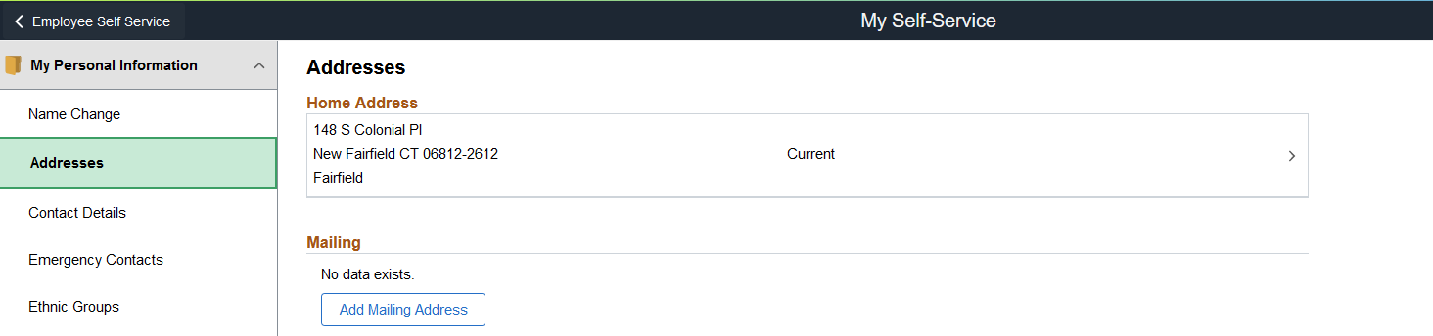
PERSONAL INFORMATION
Notes:
The “My Personal Information” option will allow you to view and update personal information such as your address.
All you have to do is click on the Addresses ribbon on the left-hand side of the page and follow the step-by-step instructions that are presented to you.
REMEMBER, it’s critical that you keep your personal information UPDATED!

Slide 9


Slide 10

Open Enrollment Dates:
October 15 - November 15 for the Aetna Health Plan
OR
November 1 - December 31 for the NYSHIP Health Plan
ACTIVE:
Subway Surface Supervisors Association (SSSA)
Transit Supervisors Organization (TSO) Operating & Queens Division (TSO-OP/QSA)
Transit Supervisors Organization (TSO) Maintenance Supervisors Level II (TSO MSI II)
MTA Bus TSO Local 106
Notes:
As a reminder, open enrollment is your once-a-year opportunity to change your health coverage options without a qualifying event.
The date of the open enrollment period for the Aetna Health Plan is October 15th - November 15th
This means that no later than November 15th, employees who currently participate or would like to participate in the Aetna Health Plan MUST submit their changes to the BSC via the open enrollment/change forms available on the My MTA Portal.
The date of the open enrollment period for the NYSHIP Health Plan is November 1st – December 31st
This means that no later than December 31st, employees who currently participate or would like to participate in the NYSHIP Health Plan MUST submit their changes to the BSC via the open enrollment/change forms available on the My MTA Portal.
All changes will be effective for January 1st of the upcoming plan year.

Slide 11
Electing & Changing Coverage
To remain in your current medical plan, no action is required from you
To make medical and/or dental plan changes and/or to add, change, or remove a dependent, you MUST submit the below enrollment form(s) as applicable:
    HR-BEN-810K 2024 Open Enrollment/Change Form for Active NYCT SSSA/TSO Operating & Queens Division/TSO MSII/MTA Bus TSO Local 106 Employees
    HR-BEN-060K 2024 NYSHIP Open Enrollment/Change Form
    HR-BEN-810N 2024 Dental Open Enrollment/Change Form for Active NYCT
    SSSA/TSO Operating & Queens Division/TSO MSII/TSO SSII/MTA Bus TSO Local 106/
    Special Inspector (UFLEO) Employees with NYSHIP Health Plan
Notes:
To remain in your current medical plan, no action is required from you
If you’re interested in making medical and/or dental plan changes or would like to add, change, or remove a dependent, you MUST submit the applicable enrollment form or forms listed on this slide.

Slide 12

Medical Opt-Out Program Guidelines & Incentives
Medical Opt-Out Period:
October 15 – November 15 for the Aetna Health Plan
November 1 - December 31 for the NYSHIP Health Plan
  You can opt-out of medical, hospital, and prescription drug coverage. You will retain your dental and vision coverage.
  The financial incentive is payable at the end of the Opt-Out Plan Year OR the beginning of the next calendar year following the end of the Opt-Out Plan Year.
NOTE:
Refer to the Open Enrollment Information Package on the open enrollment website for specific information about the financial incentive amounts and the timing of payments.
  You may re-enroll in medical, hospital, and prescription drug coverage during the next annual Open Enrollment period OR if you experience a qualifying life event (i.e., loss
  of coverage or a change in family status)
Notes:
The MTA Medical Opt-Out program enrollment period is October 15th thru November 15th for the Aetna Health Plan and November 1st thru December 31st for the NYSHIP Health Plan.
The Opt-Out program offers a financial incentive payment to employees who have alternate medical coverage.
The incentive amount as well as the timing of the payment will vary based on the terms of your Collective Bargaining Agreement.
To re-enroll in MTA-sponsored medical, hospital, and prescription drug coverage, you must either wait until the next annual open enrollment period OR if you experience a qualifying life event such as the loss of your alternate coverage.
Additional information on the MTA Medical Opt-Out Program is available within the Open Enrollment Informational Package for your group posted on the dedicated open enrollment informational site at www.mymta.info/openenrollment

Slide 13
What’s Changing?
Notes:
Now, let’s discuss what’s changing this year!

Slide 14
What’s Changing for 2024?:
For Active SSSA Employees:
Current SSSA employees who are enrolled in the NYSHIP Health Plan have the option to remain enrolled in the NYSHIP Health Plan OR have a ONE-TIME option to elect the Aetna Health Plan, effective January 1, 2024. Any such election will be permanent.
Current SSSA employees who have more than five (5), but less than ten (10) years of service have the option to remain enrolled in the Aetna Health Plan OR have a
ONE-TIME option to elect the NYSHIP Health Plan, effective January 1, 2024. Any such
election will be permanent.
Current SSSA employees who have less than five (5) years of service will continue in
the Aetna Health Plan as is.
All NEW promotions on or after June 27, 2023, will stay in the Aetna Health Plan.
The Aetna High Option Plan will be eliminated effective January 1, 2024.
Notes:
Per the Collective Bargaining Agreement for Active SSSA Employees:
Current SSSA employees who are enrolled in the NYSHIP Health Plan have the option to remain enrolled in the NYSHIP Health Plan OR have a ONE-TIME option to elect the Aetna Health Plan, effective January 1, 2024. Any such election will be permanent.
Current SSSA employees who have more than five (5), but less than ten (10) years of service have the option to remain enrolled in the Aetna Health Plan OR have a ONE-TIME option to elect the NYSHIP Health Plan, effective January 1, 2024. Any such election will be permanent.
Current SSSA employees who have less than five (5) years of service will continue in the Aetna Health Plan as is.
All NEW promotions on or after June 27, 2023, will stay in the Aetna Health Plan.
For those enrolled in the Aetna Health Plan, the Aetna High Option Plan will be eliminated effective January 1, 2024.

Slide 15
What’s Changing for 2024?:
For Active TSO Operating & Queens Division Employees:
Current TSO Operating & Queens Division employees who are enrolled in the NYSHIP Health Plan have the option to remain enrolled in the NYSHIP Health Plan OR have a ONE-TIME option to elect the Aetna Health Plan, effective January 1, 2024. Any such election will be permanent.
Current TSO Operating & Queens Division employees within the five (5) year waiting period will have the option to remain enrolled in the Aetna Health Plan OR have a
ONE-TIME option to elect the NYSHIP Health Plan, effective January 1, 2024. Any such
election will be permanent.
All NEW promotions on or after June 27, 2023, will stay in the Aetna Health Plan.
The Aetna High Option Plan will be eliminated effective January 1, 2024.
Notes:
Per the Collective Bargaining Agreement for Active TSO Operating & Queens Division Employees:
Current TSO Operating & Queens Division employees who are enrolled in the NYSHIP Health Plan have the option to remain enrolled in the NYSHIP Health Plan OR have a ONE-TIME option to elect the Aetna Health Plan, effective January 1, 2024. Any such election will be permanent.
Current TSO Operating & Queens Division employees within the five (5) year waiting period will have the option to remain enrolled in the Aetna Health Plan OR have a ONE-TIME option to elect the NYSHIP Health Plan, effective January 1, 2024. Any such election will be permanent.
All NEW promotions on or after June 27, 2023, will stay in the Aetna Health Plan.
For those enrolled in the Aetna Health Plan, the Aetna High Option Plan will be eliminated effective January 1, 2024.

Slide 16
What’s Changing for 2024?:
For Active TSO Maintenance Supervisor Level II Employees:
Current TSO MS II employees who are enrolled in the NYSHIP Health Plan have the option to remain enrolled in the NYSHIP Health Plan OR have a ONE-TIME option to elect the Aetna Health Plan, effective January 1, 2024. Any such election will be permanent.
Current TSO MS II employees who are enrolled in the Aetna Health Plan have the option to remain enrolled in the Aetna Health Plan OR have a ONE-TIME option to elect the NYSHIP Health Plan, effective January 1, 2024. Any such election will be permanent.
Current TSO MS II employees who participate in the Aetna Health Plan will contribute
2% of their gross wages on forty (40) hours per week, on a pre-tax basis, to defray the
cost of health benefits.
All NEW promotions on or after June 27, 2023, will stay in the Aetna Health Plan.
The Aetna High Option Plan will be eliminated effective January 1, 2024.
Notes:
Per the Collective Bargaining Agreement for Active TSO Maintenance Supervisor Level II Employees:
Current TSO Maintenance Supervisor Level II employees who are enrolled in the NYSHIP Health Plan have the option to remain enrolled in the NYSHIP Health Plan OR have a ONE-TIME option to elect the Aetna Health Plan, effective January 1, 2024. Any such election will be permanent.
Current TSO Maintenance Supervisor Level II employees who are enrolled in the Aetna Health Plan have the option to remain enrolled in the Aetna Health Plan OR have a ONE-TIME option to elect the NYSHIP Health Plan, effective January 1, 2024. Any such election will be permanent.
Current TSO Maintenance Supervisor Level II employees who participate in the Aetna Health Plan will contribute 2% of their gross wages on forty (40) hours per week, on a pre-tax basis, to defray the cost of health benefits.
All NEW promotions on or after June 27, 2023, will stay in the Aetna Health Plan.
For those enrolled in the Aetna Health Plan, the Aetna High Option Plan will be eliminated effective January 1, 2024.

Slide 17
What’s Changing for 2024?:
For Active SSSA/TSO Operating & Queens Division/TSO MS II Employees:
Lifetime Surviving Spouse Coverage
    For employees who are currently enrolled OR will be enrolling in the Aetna Health Plan for 2024, as an active employee, in the event of your death, your surviving spouse or domestic partner who is also enrolled in your MTA-sponsored health benefits will be eligible to continue lifetime health coverage.
    This benefit will NOT apply in the event your surviving spouse or domestic partner is otherwise entitled to health care coverage, not including Medicare, which will continue to remain primary upon
    attaining Medicare eligibility.
Notes:
Per the Collective Bargaining Agreements for Active SSSA, TSO Operating & Queens Division, & TSO Maintenance Supervisor Level II Employees:
For employees who are currently enrolled OR will be enrolling in the Aetna Health Plan for 2024, as an active employee, in the event of your death, your surviving spouse or domestic partner who is also enrolled in your MTA-sponsored health benefits will be eligible to continue lifetime health coverage.
This benefit will NOT apply in the event your surviving spouse or domestic partner is otherwise entitled to health care coverage, not including Medicare, which will continue to remain primary upon attaining Medicare eligibility.

Slide 18
What’s Changing for 2024?:
For Active MTA Bus TSO Local 106 Employees:
Current MTA Bus TSO Local 106 employees who are enrolled in the NYSHIP Health Plan have the option to remain enrolled in the NYSHIP Health Plan OR have a ONE-TIME option to elect the Aetna Health Plan, effective January 1, 2024. Any such election will be permanent.
Current MTA Bus TSO Local 106 employees within the ten (10) year waiting period will have the option to remain enrolled in the Aetna Health Plan OR have a ONE-TIME option to elect the NYSHIP Health Plan, effective January 1, 2024. Any such election will be permanent.
All NEW promotions that take place on or after full & final ratification, will stay in the Aetna Health Plan.
The Aetna High Option Plan will be eliminated effective January 1, 2024.
Notes:
Per the Collective Bargaining Agreement for Active MTA Bus TSO Local 106 Employees:
Current MTA Bus TSO Local 106 employees who are enrolled in the NYSHIP Health Plan have the option to remain enrolled in the NYSHIP Health Plan OR have a ONE-TIME option to elect the Aetna Health Plan, effective January 1, 2024. Any such election will be permanent.
Current MTA Bus TSO Local 106 employees within the ten (10) year waiting period will have the option to remain enrolled in the Aetna Health Plan OR have a ONE-TIME option to elect the NYSHIP Health Plan, effective January 1, 2024. Any such election will be permanent.
All NEW promotions on or after the date of full and final ratification will stay in the Aetna Health Plan.
For those enrolled in the Aetna Health Plan, the Aetna High Option Plan will be eliminated effective January 1, 2024.

Slide 19
January 1, 2024 Aetna Options for Active SSSA/TSO Operating & Queens Division/TSO Maintenance Supervisor II/MTA Bus TSO Local 106 Members with Aetna Health Plan
This is a summary of major in-network benefits available under each plan
 |  |  | Aetna CPOS II Basic | Aetna Select Option
Benefit |  |  | In-network (Out-of-network coverage available) | In-network (National network ONLY coverage)*
Deductible |  |  | DME $100 per person per calendar year | DME $100 per person per calendar year
Out-of-pocket maximum |  |  | N/A | N/A
Lifetime maximum |  |  | Unlimited | Unlimited
Office visits: | - Primary care office visit |  | $15 copay | 100% coverage
 | - Specialist office visit |  | $15 copay | 100% coverage
 | - Preventive care visit |  | $0 copay | 100% coverage
Inpatient hospital deductible |  |  | $50 per person per confinement; $240 per person or family max per calendar year | N/A
Inpatient hospital |  |  | 100% coverage after deductible | 100% coverage
Outpatient hospital |  |  | 100% coverage | 100% coverage
Emergency room |  |  | $100 copay | $100 copay
Mental health: | - Office visit | - Office visit | $15 copay | 100% coverage
 | - Inpatient | - Inpatient | 100% coverage after deductible | 100% coverage
Substance abuse: | - Office visit | - Office visit | $15 copay | 100% coverage
 | - Inpatient | - Inpatient | 100% coverage after deductible | 100% coverage
Behavioral/Physical/Occupational & Speech Therapy: |  |  | $15 copay | $0 copay
Notes:
In the open enrollment information package that is accessible online for Active SSSA, TSO Operating & Queens Division, TSO Maintenance Supervisor II, & MTA Bus TSO Local 106 members, you will find detailed charts listing the in-network and out-of-network benefits and copays.
All changes will be effective for January of the upcoming plan year and you will have a choice of 2 medical plan options:
The Aetna CPOS II Basic Plan is an In-network & Out-of-network plan with the following benefits:
–Nationwide coverage, so you can use it in any state within the United States
–There is no premium cost for this plan
–There is a $15 copay for primary care and specialist office visits
–There is no copay for preventative care visits
–There is a $100 copay for emergency room visits, and
–This plan provides 120 days of hospital coverage
2. The Aetna Select Option Plan is an In-network only plan with national coverage as well as the following benefits:
–There is no premium cost for this plan
–There are no copayments for medical and hospital services, and
–This plan covers 365 days of hospital coverage
Remember, for the Aetna Health Plan, all changes MUST be submitted to the BSC via the HR-BEN-810K 2024 Open Enrollment/Change Form for Active NYCT SSSA/TSO Operating & Queens Division/TSO MSII/MTA Bus TSO Local 106 Employees, no later than November 15, 2023, for changes to be effective for January of the upcoming plan year
As a Special Note for All Employees in the Aetna Health Plan Who are Planning to Retire in 2024:
If you and/or your covered dependent become Medicare-eligible as a result of reaching at least age 65 or being disabled when you retire, Medicare will be you and/or your dependent’s primary medical coverage.
Enrollment in Medicare generally takes about three months, so please contact the Social Security Administration in advance so that as a retiree, you and/or your dependent will be enrolled in Medicare Part A (hospitalization) and Medicare Part B (medical). Your medical plan choices at that time will be the Aetna CPPO Basic Option and the Aetna Medicare Advantage Options 1 or 2.

Slide 20
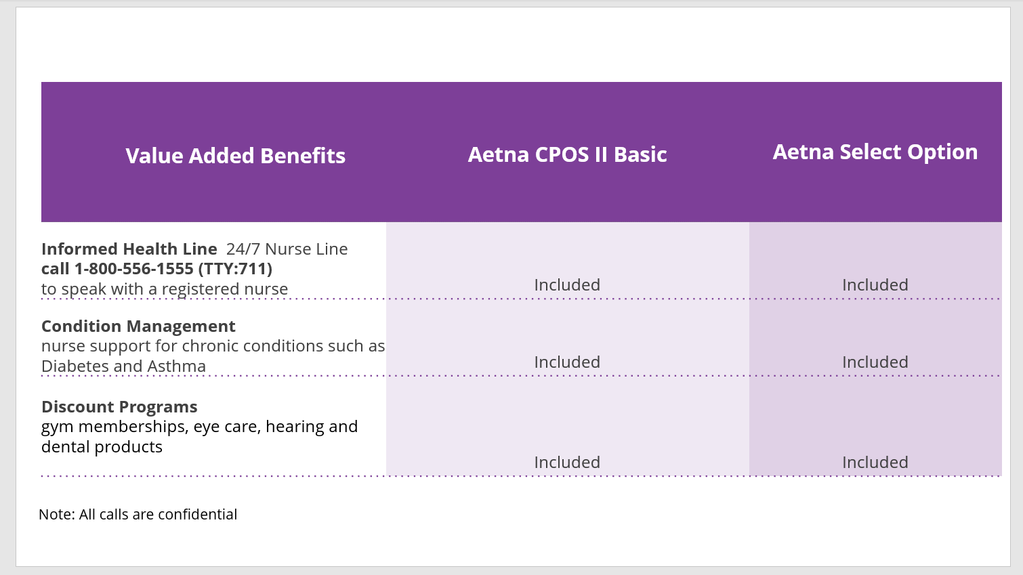
Value Added Benefits
Notes:
Along with your enrollment in an Aetna plan, comes added benefits such as:
-A 24/7 telephone line to speak with a registered nurse. Please note that all calls are confidential.
-Assistance with the management of chronic diseases, and
-Several discount programs, including discounts on gym memberships, vision, hearing, and dental products.

Slide 21
Medical Plans for Aetna Health Plan
If you have questions about your coverage, need help finding a participating provider, locating an urgent care center, or need help with a claim or understanding an Explanation of Benefits (EOB), you can contact the:
Aetna MTA NYCT Concierge by phone for a confidential chat:
1-855-824-5349 (TTY: 711)
Monday – Friday, 8a.m. – 8 p.m. ET.
https://www.aetnanyct.com
Notes:
If you have questions about your coverage, need help finding a provider, locating an urgent care center, or need help with a claim or understanding an Explanation of Benefits (EOB), you can contact Aetna Concierge at 1-855-824-5349, Monday-Friday 8am-8pm or you can visit their website at www.aetnanyct.com.

Slide 22
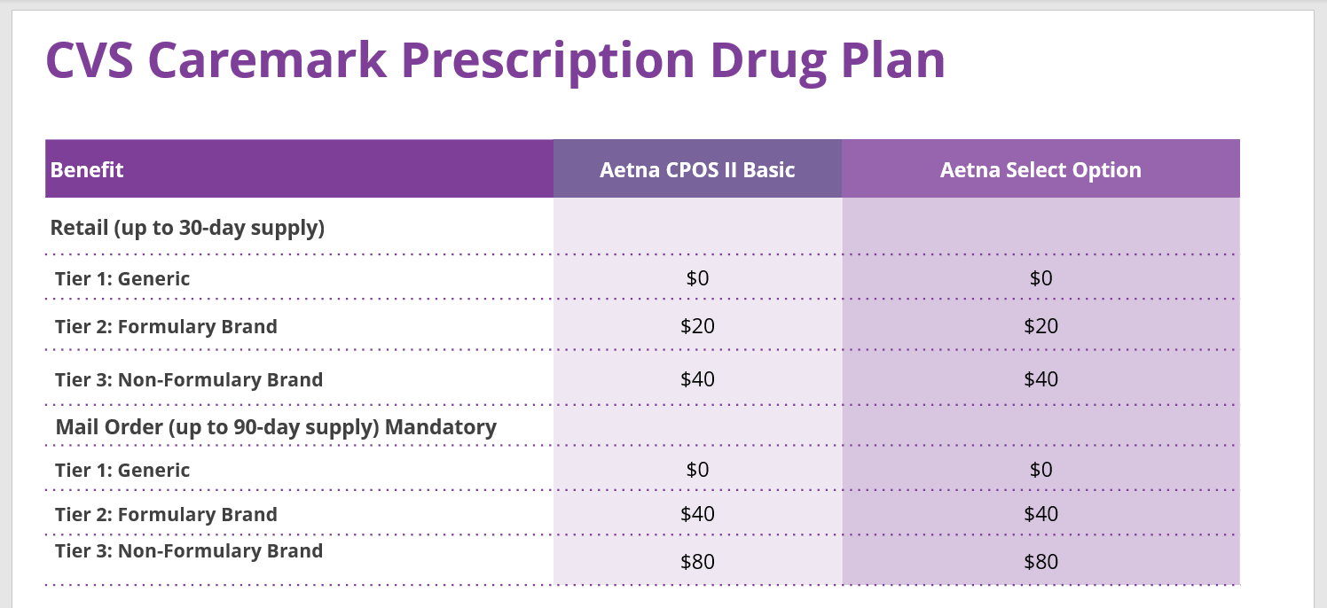
Notes:
Your prescription drug plan is administered by CVS Caremark and coverage is based on a three-tiered formulary according to the following schedule:
For Retail with a 30-Day Supply:
Generic: No cost
Formulary Brand: $20
Non-Formulary Brand: $40
For Mail Order with up to a 90-Day Supply:
Generic: No cost
Formulary Brand: $40
Non-Formulary Brand: $80
Please be advised that mail order is mandatory.
If you are on a maintenance medication, you MUST obtain your medication(s) through the CVS Caremark Mail Service Pharmacy. Any prescription drug that has been filled two times at a participating pharmacy (original prescription plus one refill) MUST be sent to the CVS Caremark Mail Service Pharmacy for all additional fills. All initial prescriptions sent to the CVS Caremark Mail Service Pharmacy MUST be sent with a new prescription from your physician and should be written for up to a 90-day supply.

Slide 23
NYSHIP Health Plan Benefits for:
Active SSSA/TSO Operating & Queens
Division/TSO MS II/MTA Bus TSO Local 106 Members
NYSHIP Offers Two (2) Different Types of Medical Plans
Participating Provide Organization (PPO) The Empire Plan | Health Maintenance Organization (HMO)
Provides a full range of health care coverage for in-network and out-of-network providers | In-network ONLY coverage
You are NOT required to choose a primary care physician (PCP) | You MUST choose a primary care physician (PCP) from the HMO network
NO referrals are needed for specialist visits | Specialist visits require referrals authorized by your PCP
PPO Plan Details | HMO Plan Details
$25 copayment for in-network primary & specialist office visits (outside of annual physical exam) | You can enroll in any NYSHIP-approved HMO plan that serves the area in which you live and/or work
120 days of in-network hospital coverage | Please review the 2024 Health Insurance Choices Guide located on the My MTA Portal to confirm if an HMO
No annual deductible for in-network services | Plan is available in your area
Notes:
The NYSHIP Health Plan offers 2 different types of medical insurance plans for you to choose from:
-1 PPO plan known as the Empire Plan, and
-Various HMO medical plans depending on where you live and/or work
The Empire Plan PPO provides a full range of health care coverage for in-network and out-of-network providers as well as the following benefits:
-Nationwide coverage, so you can use it in any state within the United States
-You are not required to choose a primary care physician (PCP)
-No referrals are needed for specialist visits, and
-There is a $25 copayment for primary care office visits outside of your annual physical exam
The variety of HMO Plans available are for in-network only coverage within specific service areas and provide the following benefits:
-You must choose a primary care physician (PCP) from the HMO’s network
-Specialist visits require referrals authorized by your PCP, and
-The copayment for primary care office visits is based on the specific HMO plan you are eligible for and select
Within the information package for Active SSSA, TSO Operating & Queens Division, TSO MS II, and MTA Bus TSO Local 106 Employees posted on the dedicated open enrollment website, you will find in-network and out-of-network benefit and copay information
Additionally, to assist with your decision-making, please refer to the 2024 NYSHIP Choices Guide, which lists your medical plan choices and is available on the My MTA Portal. The 2024 NYSHIP Choices Guide will be available on the My MTA Portal in December.
Remember, for the NYSHIP Health Plan, all changes MUST be submitted to the BSC via the HR-BEN-060K 2024 NYSHIP Open Enrollment/Change form, no later than December 31, 2023, for changes to be effective for January of the upcoming plan year
As a Special Note for All Employees in the NYSHIP Health Plan Who are Planning to Retire in 2024:
If you and/or your covered dependent become Medicare-eligible as a result of reaching at least age 65 or being disabled when you retire, Medicare will be you and/or your dependent’s primary medical coverage. This will occur on the first of the month or the following month coinciding with your retirement date.
Enrollment in Medicare generally takes about three months, so please contact the Social Security Administration in advance so that as a retiree, you and/or your dependent will be enrolled in Medicare Part A (hospitalization) and Medicare Part B (medical) upon retirement.

Slide 24
Prescription Drug Plan for:
Active SSSA/TSO Operating & Queens
Division/TSO MS II/MTA Bus TSO Local 106 Members Enrolled in NYSHIP Health Plan
  Under NYSHIP, prescription drugs are part of your medical plan, whether you join The Empire Plan (PPO) or one of the HMOs.
For The Empire Plan (PPO), prescription drugs are through CVS Caremark.
Notes:
Under the NYSHIP Health Plan, prescription drugs are part of your medical coverage regardless of whether you join the PPO plan or one of the many HMO plans.
For the Empire Plan PPO, CVS Caremark will be your prescription drug carrier.

Slide 25
Medical Plans for NYSHIP Health Plan
If you need New York State Health Insurance Program (NYSHIP) medical, hospital, and prescription drug coverage information or need help finding a participating provider, you can visit the NYSHIP website at:
www.cs.ny.gov/employee-benefits
Notes:
If you have any questions about your coverage, need detailed NYSHIP medical plan summaries, or need help finding a provider, you can visit the NYSHIP website at www.cs.ny.gov/employee-benefits

Slide 26
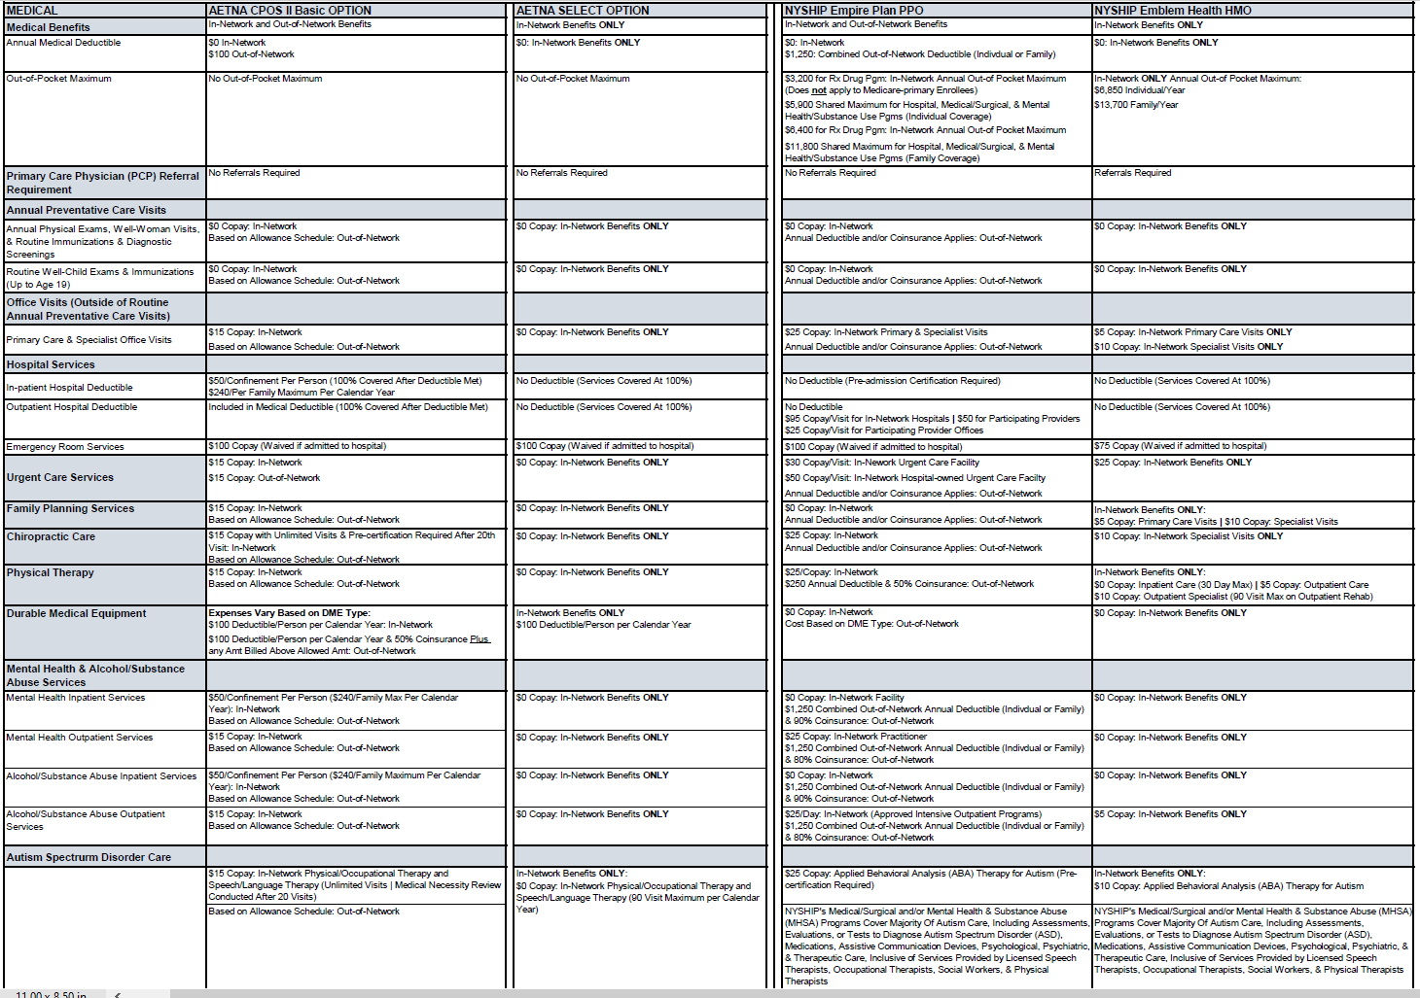
2024 Health Plan Highlights for Active SSSA/TSO Operating & Queens Division/TSO Maintenance Supervisor II/MTA Bus TSO Local 106 Members
Notes:
Within the open enrollment information package accessible online for Active SSSA, TSO Operating & Queens Division, TSO Maintenance Supervisor II, & MTA Bus TSO Local 106 members, you will find this detailed side-by-side chart which provides medical and prescription drug plan highlight information for both the Aetna health plan and the NYSHIP health plan
For those members who per the collective bargaining agreements have a ONE-TIME opportunity during open enrollment this year to select between the Aetna health plan or the NYSHIP health plan, this chart gives you a quick snapshot of some of the differences between the two plans
You can find the open enrollment information package that contains this chart posted on the dedicated open enrollment informational site at www.mymta.info/openenrollment

Slide 27
Dental Plan Options for:
Active SSSA/TSO Operating & Queens
Division/TSO MS II/MTA Bus TSO Local 106 Members
CIGNA Offers Two (2) Different Types of Dental Plans
CIGNA PPO | CIGNA DHMO
Provides for in-network and out-of-network coverage | Provides for in-network ONLY coverage
Notes:
Active SSSA, TSO Operating & Queens Division, TSO Maintenance Supervisor Level II, & MTA Bus TSO Local 106 members have a choice between two (2) dental plans, regardless of whether they are enrolled in the Aetna Health Plan or the NYSHIP Health Plan for their medical coverage:
The Cigna PPO Plan which provides in-network and out-of-network dental coverage. With this dental plan, if you use an in-network provider you will have less out of pocket expenses
You are also eligible for the Cigna DHMO Plan, which provides in-network only coverage. With this dental plan, if you use an out-of-network provider, you will be responsible for paying the full cost
To enroll in or make changes to your dental plan, you MUST complete and submit to the BSC, the HR-BEN-810N 2024 Dental Open Enrollment/Change Form
Please remember:
For those currently enrolled in or who will be enrolling in the Aetna Health Plan, dental changes MUST be submitted to the BSC no later than November 15th
via the HR-BEN-810K 2024 Open Enrollment/Change Form available on the dedicated open enrollment informational site
For those currently enrolled in or who will be enrolling in the NYSHIP Health Plan, dental changes MUST be submitted to the BSC no later than December
31st via the HR-BEN-810N Dental Open Enrollment/Change Form available on the dedicated open enrollment informational site

Slide 28

Vision Coverage
Active employees enrolled in the Aetna Health Plan OR the NYSHIP Health Plan
are eligible for vision coverage through EyeMed
If you have questions about your vision coverage, need a detailed vision plan summary, or need help finding a provider, you can contact EyeMed at:
866-299-1358
OR you can visit their website at:
eyemed.com
Notes:
Active employees and their covered dependents enrolled in either the Aetna Health Plan OR the NYSHIP Health Plan are eligible for vision coverage through EyeMed
If you have questions about your vision coverage, need a detailed vision plan summary, or need help finding a provider, you can contact EyeMed at 866-299-1358, or you can visit their website at eyemed.com

Slide 29
Tax-Favored Programs
Notes:
Now, let’s discuss Tax-Favored Programs!

Slide 30


Flexible Spending Account (FSA) Plan
Enrollment Period: November 1 – December 15
Health Care Amount for 2023
  Minimum: $ 100
  Maximum: $3,050
Dependent Care Amount
  Maximum: $5,000
For more information or to enroll in the FSA Plan, please visit the P&A Group website at www.padmin.com
To enroll via phone, call 347-506-1835
For any other questions, please call 1-800-688-2611
Notes:
Enrollment for the FSA Plan – Flexible Spending Account Plan – is open from November 1st through December 15th
The current 2023 maximum for the Health Care FSA is $3,050 and the Dependent Care FSA maximum is $5,000. Please note that the IRS has not released the 2024 limits yet. During Open Enrollment, you can check www.padmin.com to confirm the 2024 maximum amount.
To enroll in FSA, please visit the P&A Group website at www.padmin.com OR use their Interactive Voice Response system at 347-506-1835
Remember, your enrollment for the current year does NOT carry over, so you must re-enroll every year

Slide 31



Deferred Compensation Program
The Deferred Compensation Program is made
up of two separate defined contribution plans:
      401 (k) Plan
      457 Plan
Both plans allow pre-tax contributions and
after-tax (Roth) contributions
Contributions are made via payroll deduction
Enroll and make election changes through Empower (formerly Prudential) at www.prudential.com/mta or by calling
877-756-4682
Notes:
The Deferred Compensation Program helps supplement your existing retirement and/or pension benefits by allowing you to save and invest pre-tax money through the convenience of automatic payroll deductions
At any time, you can enroll and/or adjust the amount of your deductions
Additional information on the Deferred Compensation Program is available on the dedicated open enrollment site, but you will need to go to the Empower website if you’re interested in enrolling in the program

Slide 32


NY 529 College Savings Program
An investment account you can use for higher-education savings for your child, grandchild, friend, or even yourself.
Open an account with any amount – no minimum investment.
Contribute on a post-tax basis via direct deposit from your paycheck.
The money in your 529 Direct Plan account grows deferred from federal and state income taxes.
Account owners benefit from a NYS income tax deduction for New York taxpayers of up to $10K on account contributions.
You won't have to pay federal or state income taxes on money withdrawn to pay for qualified higher education expenses.
You may enroll at any time at: www.ny529atwork.org or call 800-420-8580
Notes:
The 529 College Savings Program is an investment account with no minimum investment amount that you can use for higher-education savings for your child, grandchild, friend, or even yourself
You contribute to the 529 account on a post-tax basis via direct deposit from your paycheck and the money grows tax-deferred from federal and state income taxes
You can enroll in the 529 College Savings Program at any time by visiting the New York 529 website or calling 800-420-8580

Slide 33
Commuter Benefit Plan
Set aside money for commuting (transit and parking) expenses on a pre-tax basis through automatic payroll deductions.
Certain limits apply as established by the IRS.
You may enroll at any time by contacting the plan administrator, HealthEquity/WageWorks at:
    877-924-3967
    www.healthequity.com/wageworks
Notes:
The commuter benefit program allows you to set aside money on a pre-tax basis through automatic payroll deductions for commuting expenses for you and your family, up to specific limits as established by the IRS
You may enroll at any time via the HealthEquity/WageWorks website or by contacting them at 877-924-3967

Slide 34
Resources
Notes:
To ensure the timely receipt and processing of your open enrollment request, here are some additional resources and information

Slide 35

Submission of Enrollment Forms & Contact Information
Submit Forms to the MTA Business Service Center
Email: bsc-benefits@mtabsc.org
Fax: 212-852-8700
Contact the MTA Business Service Center
Phone: 646-376-0123
Email: bscservice@mtabsc.org
Hours: 8:30 a.m. - 5 p.m.
Monday – Friday
Dedicated Open Enrollment Informational Site
www.mymta.info/openenrollment
Notes:
You MUST submit your open enrollment/change forms AND any required supporting documentation by the end of your respective open enrollment period via email to bsc-benefits@mtabsc.org OR via fax to 212-852-8700
You can visit the dedicated open enrollment informational site at www.mymta.info/openenrollment to access the open enrollment package and open enrollment forms specific to your group

Slide 36
Acceptable E-Mail File Attachments
The following are the ONLY document types that are acceptable & will be processed by the MTA Business Service Center:
      Preferred File Format: .pdf (Adobe PDF)
      .tif (image)
      .jpg (image)
      .doc OR .docx (Word document)
      .xls OR .xlsx (Excel file)
The following document types are NOT acceptable & will NOT be processed by the MTA Business Service Center:
      ANY attachment exceeding 2 MB
      Interactive or fillable PDFs (i.e., PDFs requiring input)
      Read-only Microsoft documents
      ANY password-protected attachments
      Attachments with ".unk" OR ".zip" OR “. HTML” file extensions
      Macro-enabled Word and/or Excel documents
      “Forwards" of a forwarded email (attachments cannot be forwarded twice)
Notes:
Please note - the MTA BSC can only accept the specific file types listed in this slide
Any open enrollment/change forms or supporting documentation submitted in a file type that is unacceptable as listed here, will not be processed
Remember, the preferred file format is Adobe PDF

Slide 37
Contact Info
Contact the MTA Business Service Center (BSC)
Email: bscservice@mtabsc.org
Phone: 646-376-0123
Notes:
You can contact the MTA BSC Team, 8:30 a.m. - 5 p.m., Monday – Friday at 646-376-0123 or via email at bscservice@mtabsc.org
If contacting us via telephone, please ensure to have your BSC ID# handy
If sending us an email, please remember to include your full name and BSC ID# within the body of the email and to also indicate your BSC ID# on every page of any documents you attach to the email
Thank you for your time in learning more about the MTA’s annual benefits open enrollment period and the options available to you!

